Slide 1
US Presidential Election Data, 1900-2020
Melissa schaper0
cs688

Slide 2
US Election Data project plan
Data Collection.R
Create Dataframe.R
Election Analysis.R
Election Analysis Maps.R

Slide 3
US Election Data Source
Dave Leip's Atlas of U.S. Elections
http://uselectionatlas.org/RESULTS/national.php?off=99
US President - State-Level All-Time Vote Data Spreadsheet (1824 - 2012 Pres.)
StateLevelData.xlsx
Use 1900-2012 by copying into .csv files
US President - State-Level Data for 2016, 2020
“Data Collection.R”: Scraped from url
http://uselectionatlas.org/RESULTS/data.php?year=2020&datatype=national&def=1&f=0&off=0&elect=0
http://uselectionatlas.org/RESULTS/data.php?year=2016&datatype=national&def=1&f=0&off=0&elect=0“
Manually copied from above url into .csv
List of state abbreviations
http://github.com/jasonong/List-of-US-States/blob/master/states.csv
Saved into .txt file

Slide 4
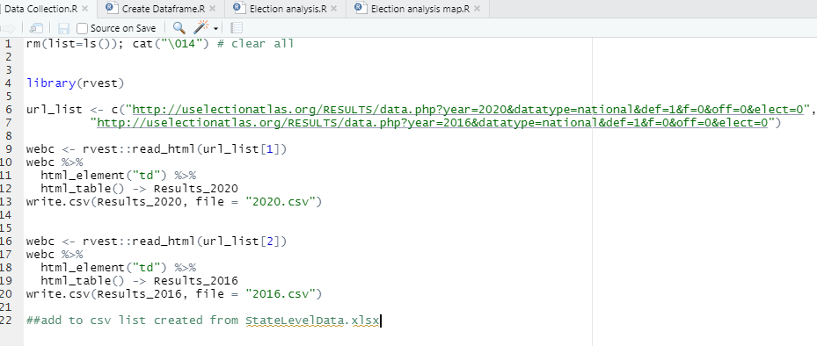
US Election Data Source

Slide 5
Create Dataframe.R
Create file paths and file lists within project directory
read in files
Candidates.csv, All election year csv, states.txt
Set names of data.frame
Add variable indicating winner of state
add variable with color indicating winner
Add state abbreviations
Originally used state.abb(), but did not accurately match
Save as .Rdata file

Slide 6

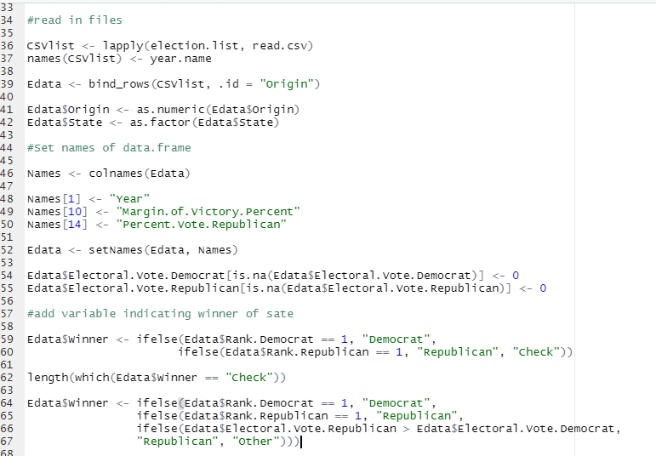

Create Dataframe.R

Slide 7
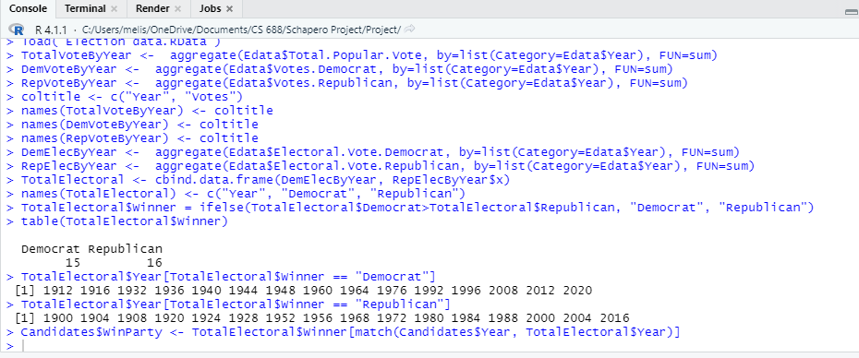
Election Analysis
Find total popular votes overall and for each party by year
Find total electoral votes for each party by year
Determine election winners
Added to Candidates dataframe

Slide 8
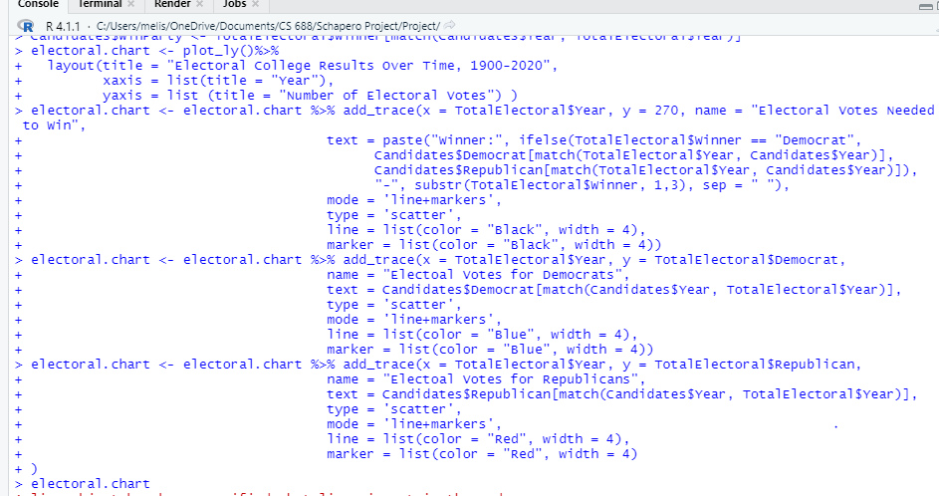
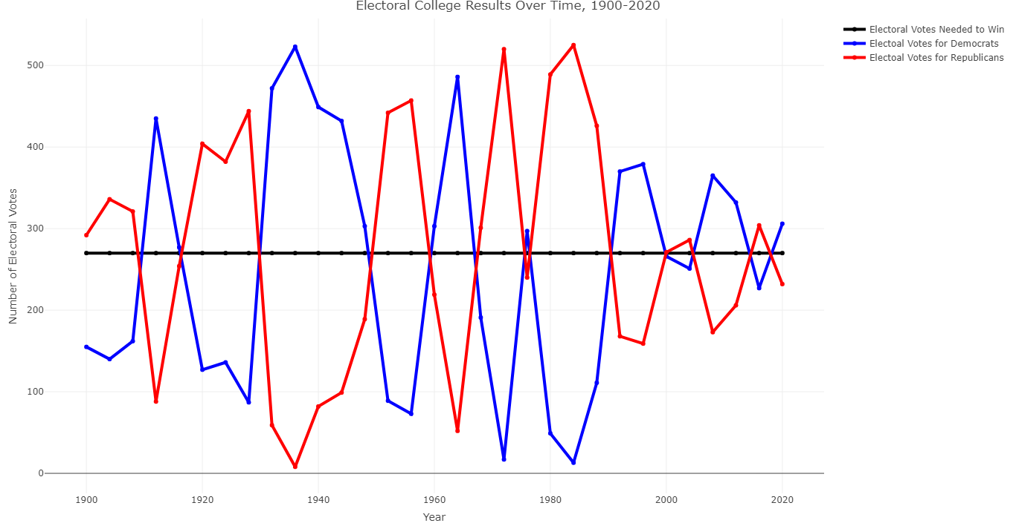
Election Analysis
Graph electoral vote over time
Project\Presidential.Winners.Over.Time.html

Slide 9
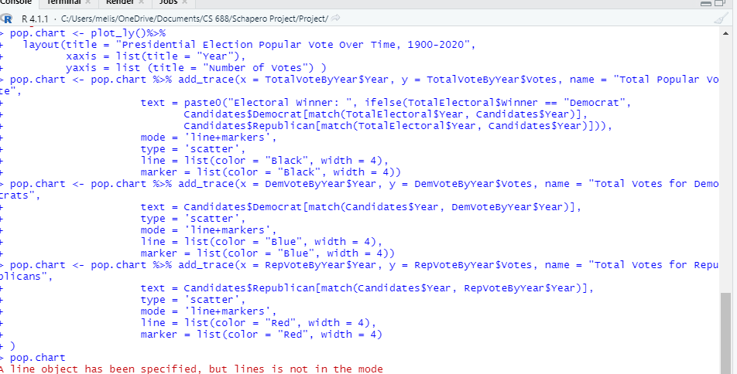
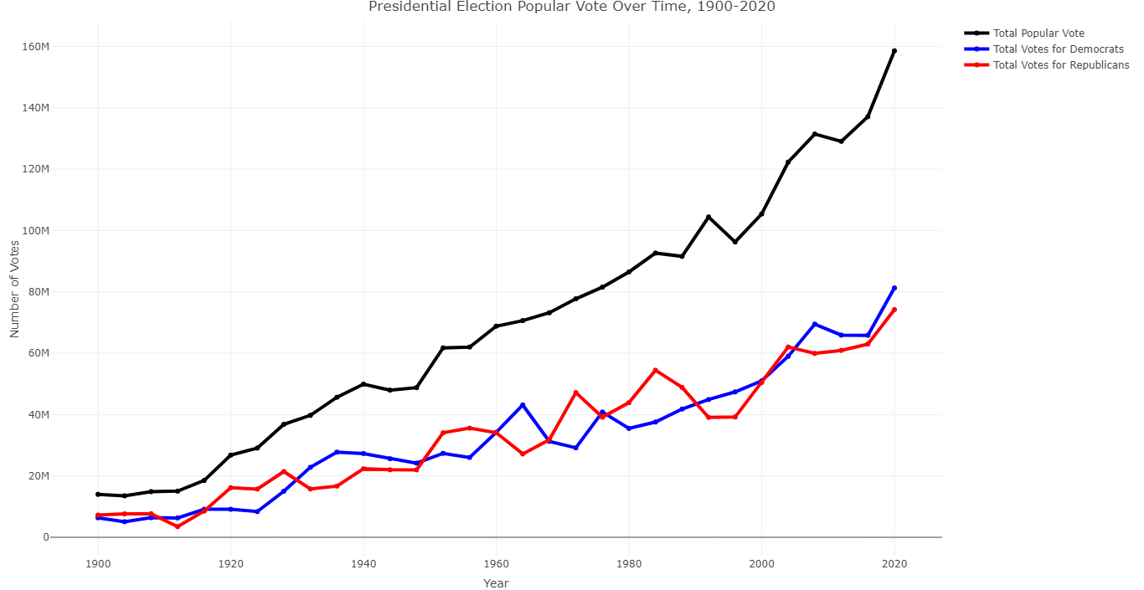
Election Analysis
Graph popular vote over time
Project\Presidential.Election.Popular.Vote.Over.Time.html

Slide 10
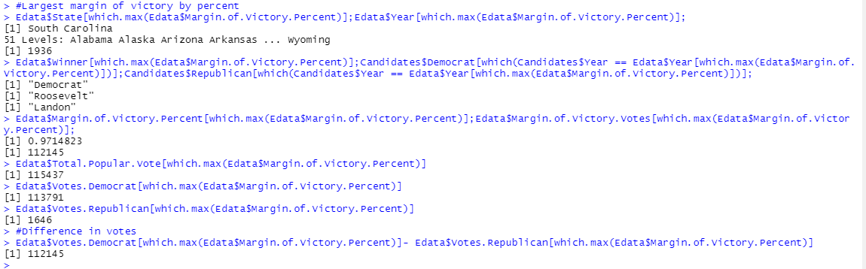
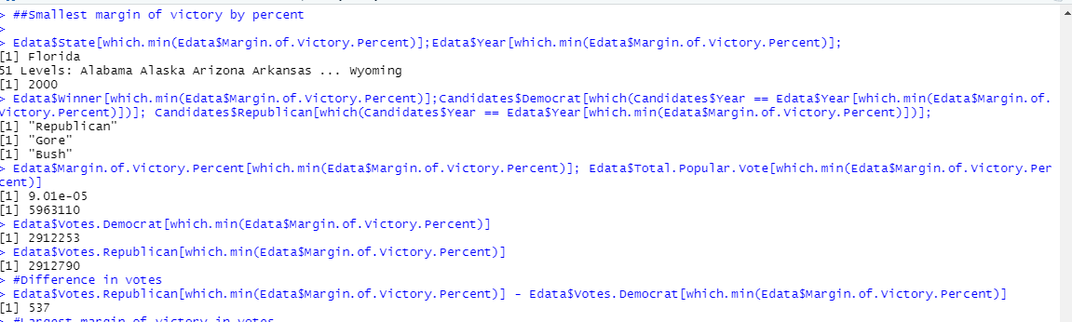
Election Analysis – Find Extremes
Largest margin of victory by percent
South Carolina, 1936, Democrat winner
Roosevelt (D) vs. Landon (R)
Roosevelt: 113791 votes
Landon: 1646 votes
97.1% (112145 votes) of 115,437 votes
Smallest margin of victory by percent
Florida, 2000, Republican winner
Gore (D) vs. Bush (R)
Gore: 2912253 votes
Bush: 2912790
.000901% (537 votes) of 5963110 votes

Slide 11
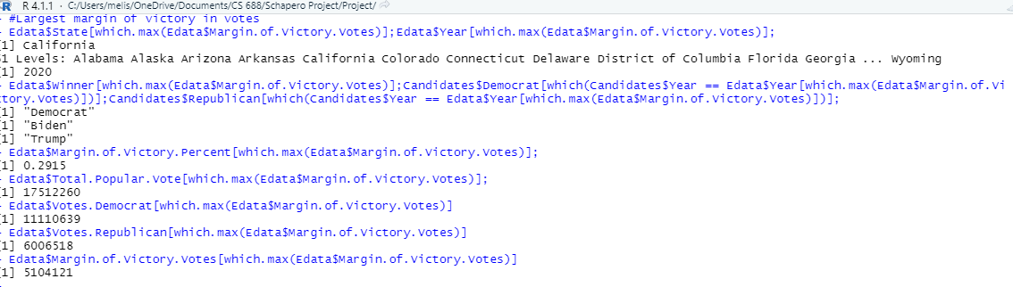
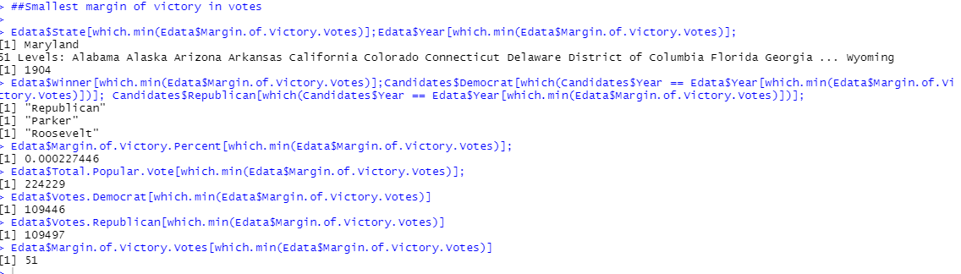
Election Analysis – Find Extremes
Largest margin of victory in votes
California, 2020, Democrat winner
Biden (D) vs. Trump (R)
Biden: 11110639 votes
Trump: 6006518 vorwa
5104121 (29.15%) of 17512260 votes
Smallest margin of victory in votes
Maryland, 1904, Republican winner
Parker (D) vs. Roosevelt (R)
Parker: 109446 votes
Roosevelt: 109497 votes
51 (0.0227446%) of 224229 votes

Slide 12

Election Analysis – Individual State Data
state.record <- split(Edata, Edata$ST)
How Often does CA winning candidate is elected?
80.64516%
How Often does TX winning candidate is elected?
64.51613%
How Often does FL winning candidate is elected?
74.19355%
How Often does OH winning candidate is elected?
90.32258%

Slide 13
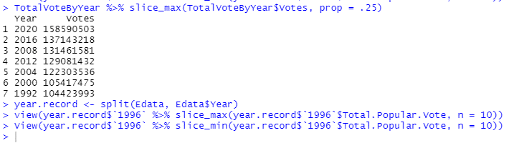
Election Analysis – Top Popular Vote Years
Top 25%
Year Votes
1 2020 158590503
2 2016 137143218
3 2008 131461581
4 2012 129081432
5 2004 122303536
6 2000 105417475
7 1992 104423993
Where’s 1996? What’s going on there?

Slide 14
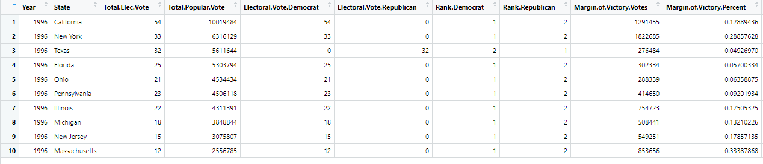
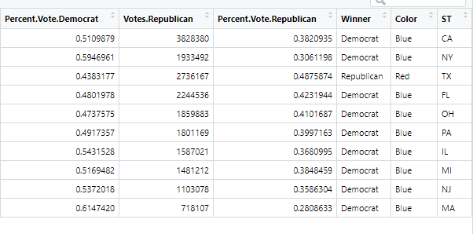
Election Analysis – 1996 top voting states

Slide 15
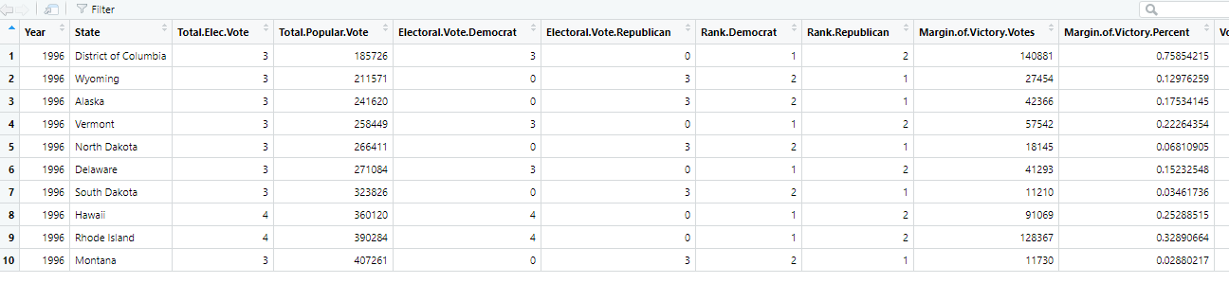
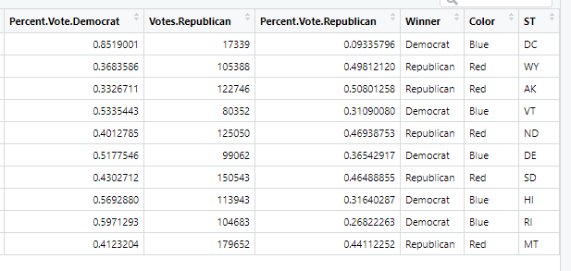
Election Analysis – 1996 minimum voting states

Slide 16
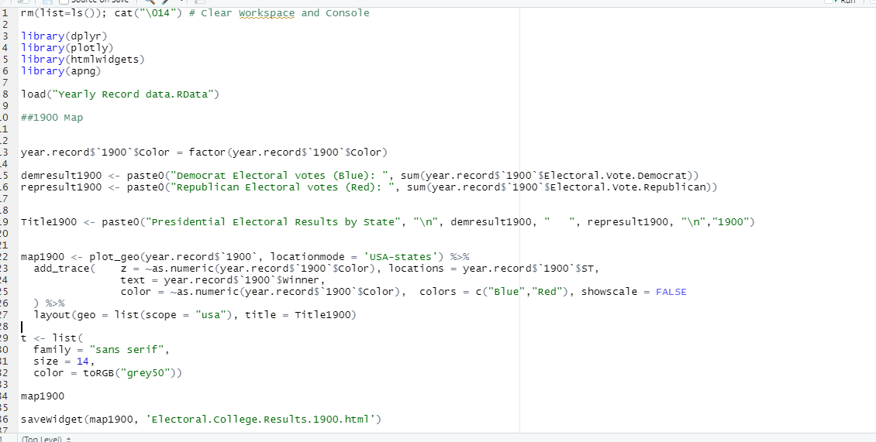
Election Results Maps by Year
How do state change politically over time?

Slide 17
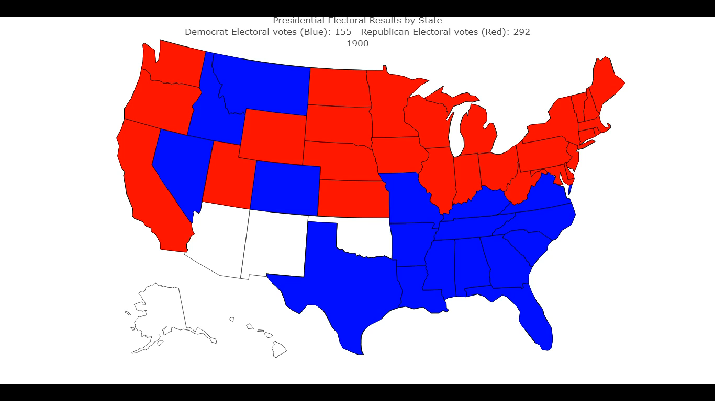
Election Results Maps by Year

Slide 18
Plot.ly charts available online
https://github.com/MSchapero/CS688Project

